Slide 1
Managing State Information

Slide 2
Credits
Some of the contents of this slide presentation have been referenced and reproduced from the textbook for this course, PHP Programming with MySQL (Second Edition) , Don Gosseling, Diana Kokoska, and Robert Easterbrooks, ©2011, Cengage Learning, All Rights Reserved. ISBN 978-0-5387-4584-0.
Thank you for some references to Kevin Skoglund, from PHP with MySQL Essential Training (2013), ©2017 LinkedIn Corporation.

Slide 3
LEARNING OBJECTIVES
Learn about state information
Use hidden form fields to save state information
Use query strings to save state information
Use cookies to save state information
Use sessions to save state information

Slide 4
Managing State Information
Introduction
HTTP was originally designed to be stateless
Web pages stored no data about pages viewed on previous visits to a site
Maintaining state
Storing persistent data about a Web site visit
Techniques
Hidden form fields
Query strings
Cookies
Sessions

Slide 5
Managing State Information
Understanding State Information
A stateless design is highly efficient, but limiting
Quick, no special information needed to load a particular Web page from a server
Web server can’t remember individual user information
Treats each visit as an entirely new session
Limits interactivity and amount of personal information
Reasons to maintain state information
Page access control
Consistent user experience
Ability to use browsing history

Slide 6
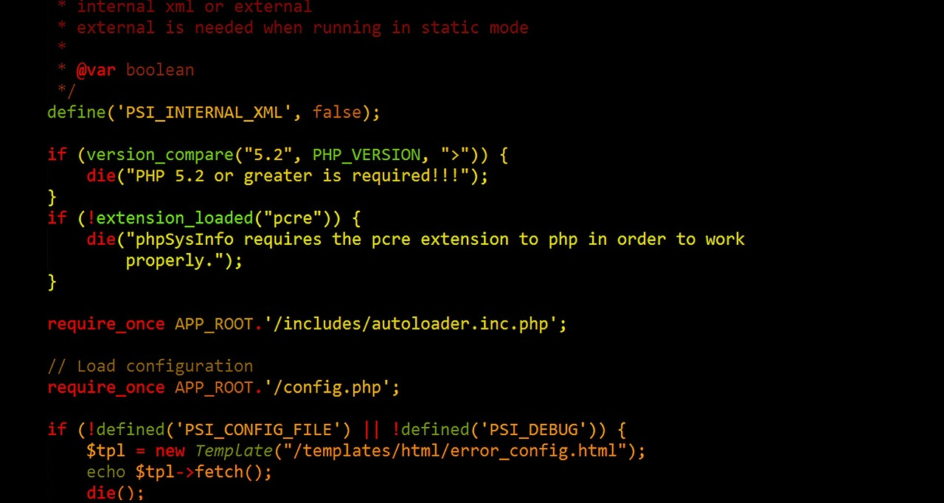
Managing State Information
Programming Exercise 02_09_01 – Step 1
Create a Database for the Exercise

Slide 7
Managing State Information
Programming Exercise 02_09_01 – Step 2
Create a Registration / Login Page

Slide 8
Managing State Information
Programming Exercise 02_09_01 – Step 3
Create a New Intern Registration Page

Slide 9
Managing State Information
Programming Exercise 02_09_01 – Step 4
Connect to the Database

Slide 10
Managing State Information
Programming Exercise 02_09_01 – Step 5
Adding a User to the Database

Slide 11
Managing State Information
Maintaining State with Hidden Form Fields
Not displayed by the Web browser
Allows information to be hidden from the user
Can be sent to the server with the rest of the form
Use the name and value attributes
Will be sent to the server on a submit with the rest of the form
Probably sensitive data, so should always use a post method

Slide 12
Managing State Information
Programming Exercise 02_09_01 – Step 6
A Verify Login Form with a Hidden Input

Slide 13
Managing State Information
The $_REQUEST Superglobal
Contains all of the associative array elements of $_GET, $POST, and $_COOKIE superglobals
Very convenient for an app which may be reached by differing methods
Also useful for state information passed with cookies

Slide 14
Managing State Information
Programming Exercise 02_09_01 – Step 7
An Available Opportunities Form Using the State

Slide 15
Managing State Information
Query Strings to Pass State
Query strings are appended to the end of a URL
They consist of name/value pairs
We often use hyperlinks with appended query strings to produce a GET method
Query strings are automatically appended to the URL on forms submitted with the GET method
The data becomes available in both the $_GET and $_REQUEST superglobals

Slide 16
Managing State Information
Programming Exercise 02_09_01 – Step 8
Using URL Query Strings

Slide 17
Managing State Information
Using Cookies to Save State Information
The method of passing state needs to take into account whether the state remains available after the current session of a Web page
Should information be persistent?
Hidden form fields and query strings disappear after the current session
Cookies may be used to provide persistent state information

Slide 18
Managing State Information
Using Cookies to Save State Information
There are two types of cookies
Temporary cookies remain available only for the current Web session
Persistent cookies remain available after current session
Stored in a text file on the client computer

Slide 19
Managing State Information
Using Cookies to Save State Information
Creating cookies
To omit value, path, or domain arguments, set them to an empty string
To omit expires or secure arguments, set them to 0
The function must be called before sending any output to the browser
Includes HTML elements, white space, echo() or print() output

Slide 20

Managing State Information
Using Cookies to Save State Information
Setting temporary cookies
Set the cookie with only the name and value arguments
Can be called multiple times

Slide 21


Managing State Information
Using Cookies to Save State Information
Storing cookies in arrays
Indexed
Associative

Slide 22
Managing State Information
Programming Exercise 02_09_01 – Step 9
Using Temporary Cookies to Save State

Slide 23
Managing State Information
Using Cookies to Save State Information
Setting persistent cookies
Must set the cookie with the expires argument
Determines how long a cookie can remain on a client system before it is deleted
The following code specifies a cookie which expires one hour from the current time

Slide 24
Managing State Information
Programming Exercise 02_09_01 – Step 10
Using Persistent Cookies to Save State

Slide 25
Managing State Information
Using Cookies to Save State Information
The path argument
Determines availability of a cookie to other Web pages on a server
Default is all pages in the same folder and subfolders
The path argument sets availability to all pages in the path and all of its subdirectories
All directories on a server and a directory path:

Slide 26

Managing State Information
Using Cookies to Save State Information
The domain argument
Determines availability of a cookie to multiple servers in the same domain:

Slide 27
Managing State Information
Using Cookies to Save State Information
Reading cookies
Cookies available to the current Web page are automatically assigned to the $_COOKIES superglobal
Deleting cookies
Temporary cookies do not have to be deleted, they expire at end of session
Persistent cookies automatically delete themselves at expiration
To delete a cookie early, update the expires argument to a time in the past

Slide 28
Managing State Information
Programming Exercise 02_09_01 – Step 11
Reading Cookies

Slide 29
Managing State Information
Using Sessions to Save State Information
Cookies can cause certain security problems
Cannot insure the security of every client computer
Private information stored in cookies may be accessible to hackers
Highly vulnerable to spyware
Session
The period of activity when a PHP script can store state information on a Web server
Similar to a temporary cookie: only available for current browser session
More secure (on server), gets around disabling cookies

Slide 30
Managing State Information
Using Sessions to Save State Information
Starting a session, or continuing an existing one, uses the session_start()function
Generates unique session ID like 7f39d7dd020773f115d753c71290e11f
Creates a text file on the server with the same name as the session ID, preceded by sess_
Like cookies, must be called before any output

Slide 31

Managing State Information
Using Sessions to Save State Information
Passing a session ID
Session ID is also assigned to a temporary cookie named PHPSESSID
Because cookies may not be enabled, also pass the ID as a query string
PHP also uses a constant named SID which contains the string “PHPSESSIID=“ and the session id, but dangerous as server may not be configured for it

Slide 32
Managing State Information
Programming Exercise 02_09_01 – Step 12
Modify Registration / Login to Use Session

Slide 33
Managing State Information
Using Sessions to Save State Information
Using session variables to save state
Session information can be stored in the $_SESSION superglobal
A session_start() call either initializes a new superglobal or retrieves any variables for the current session based on the session ID
Deleting a session
Use an array constructor to wipe out the superglobal $_SESSION = array()
Destroy the session session_destroy()

Slide 34
Managing State Information
Programming Exercise 02_09_01 – Step 13
Using Session Variables to Save State

